Slide 1
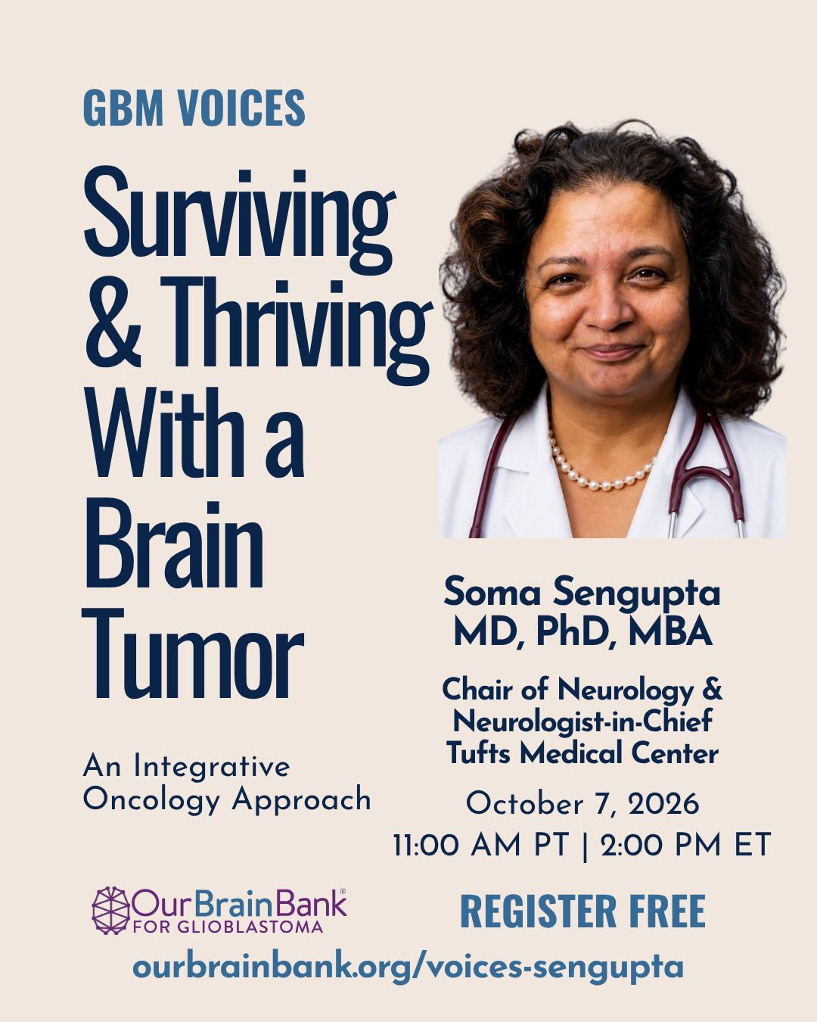

Slide 2
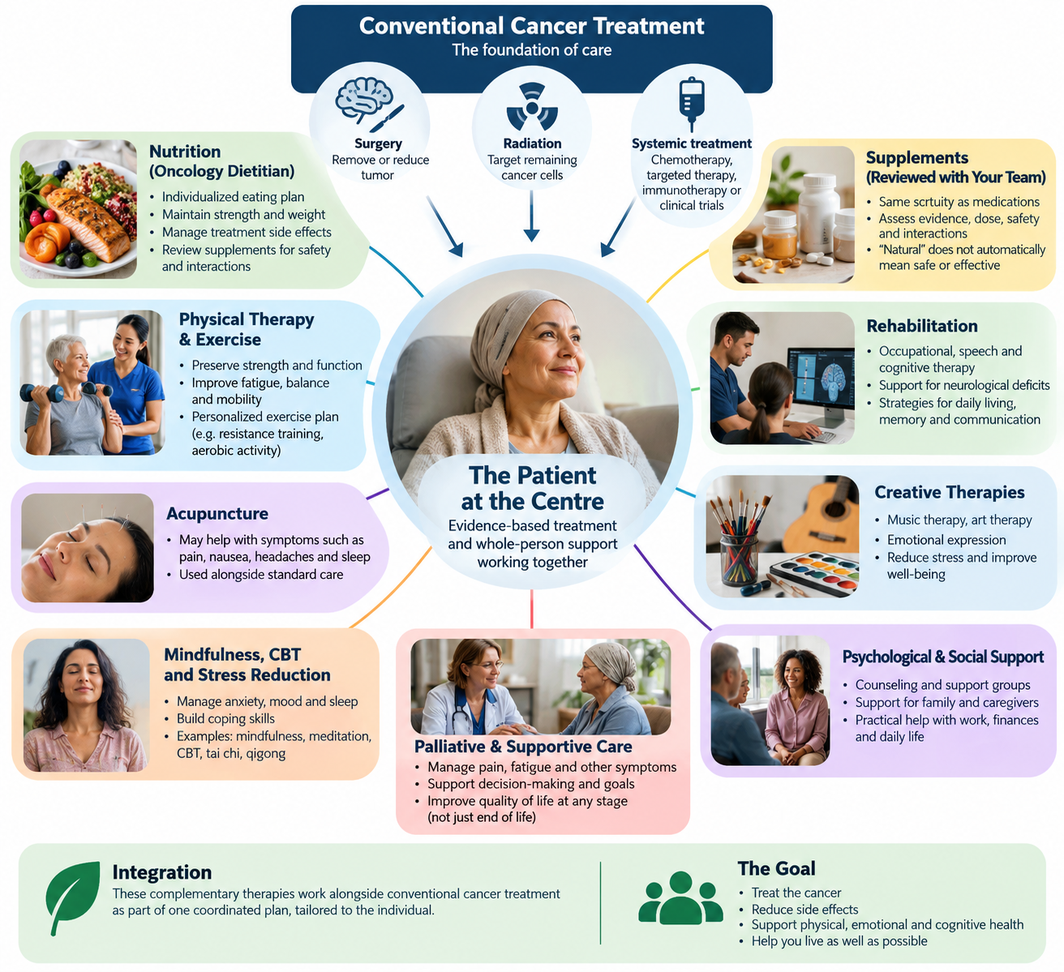
What would complementary therapies look like in practice?

Slide 3
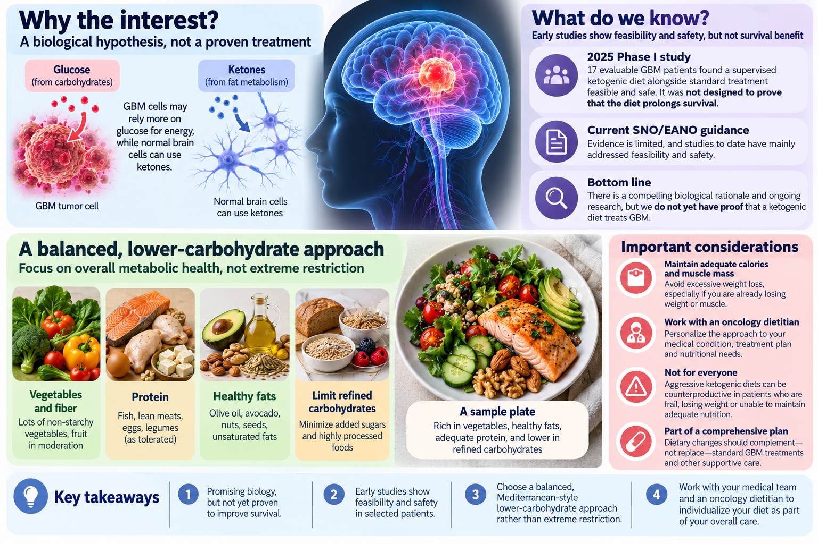
What should people with GBM know about a low-carbohydrate, high-healthy-fat diet?

Slide 4
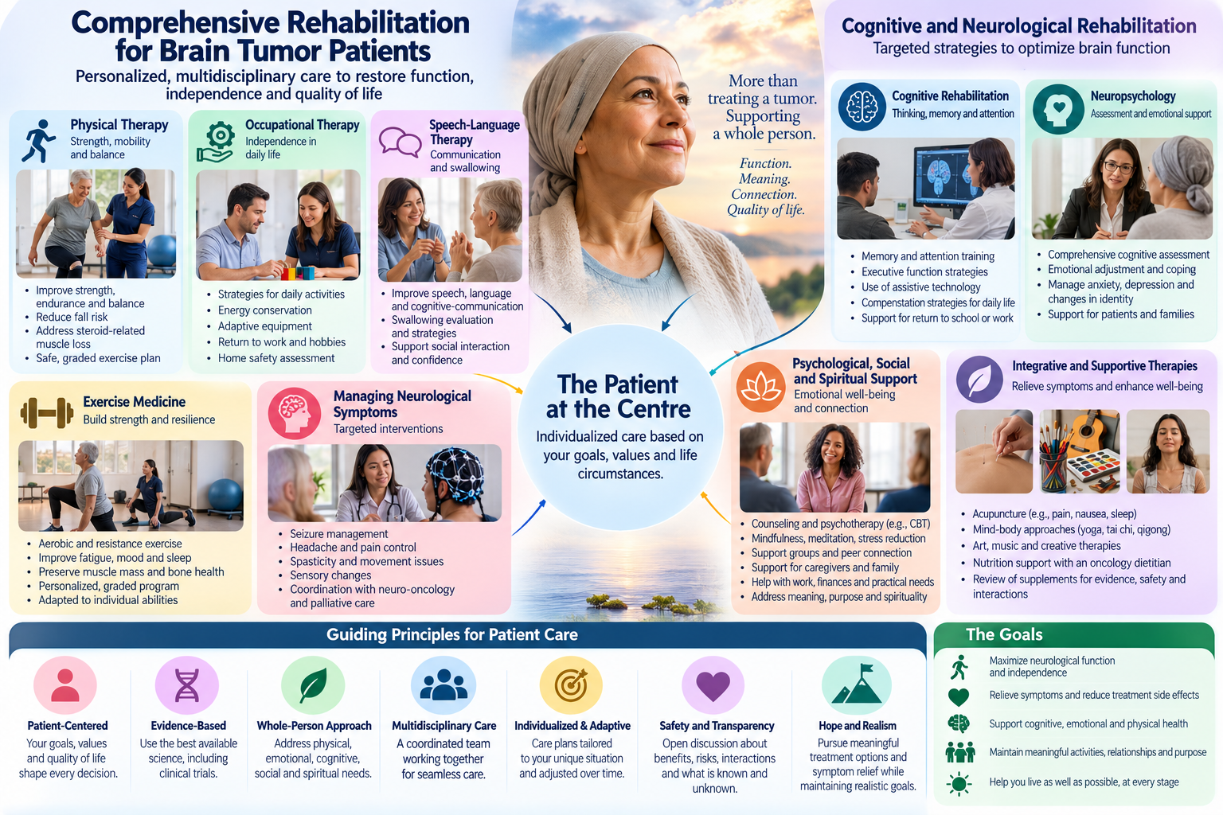
What can restore neurological function and improve quality of life?

